Slide 3
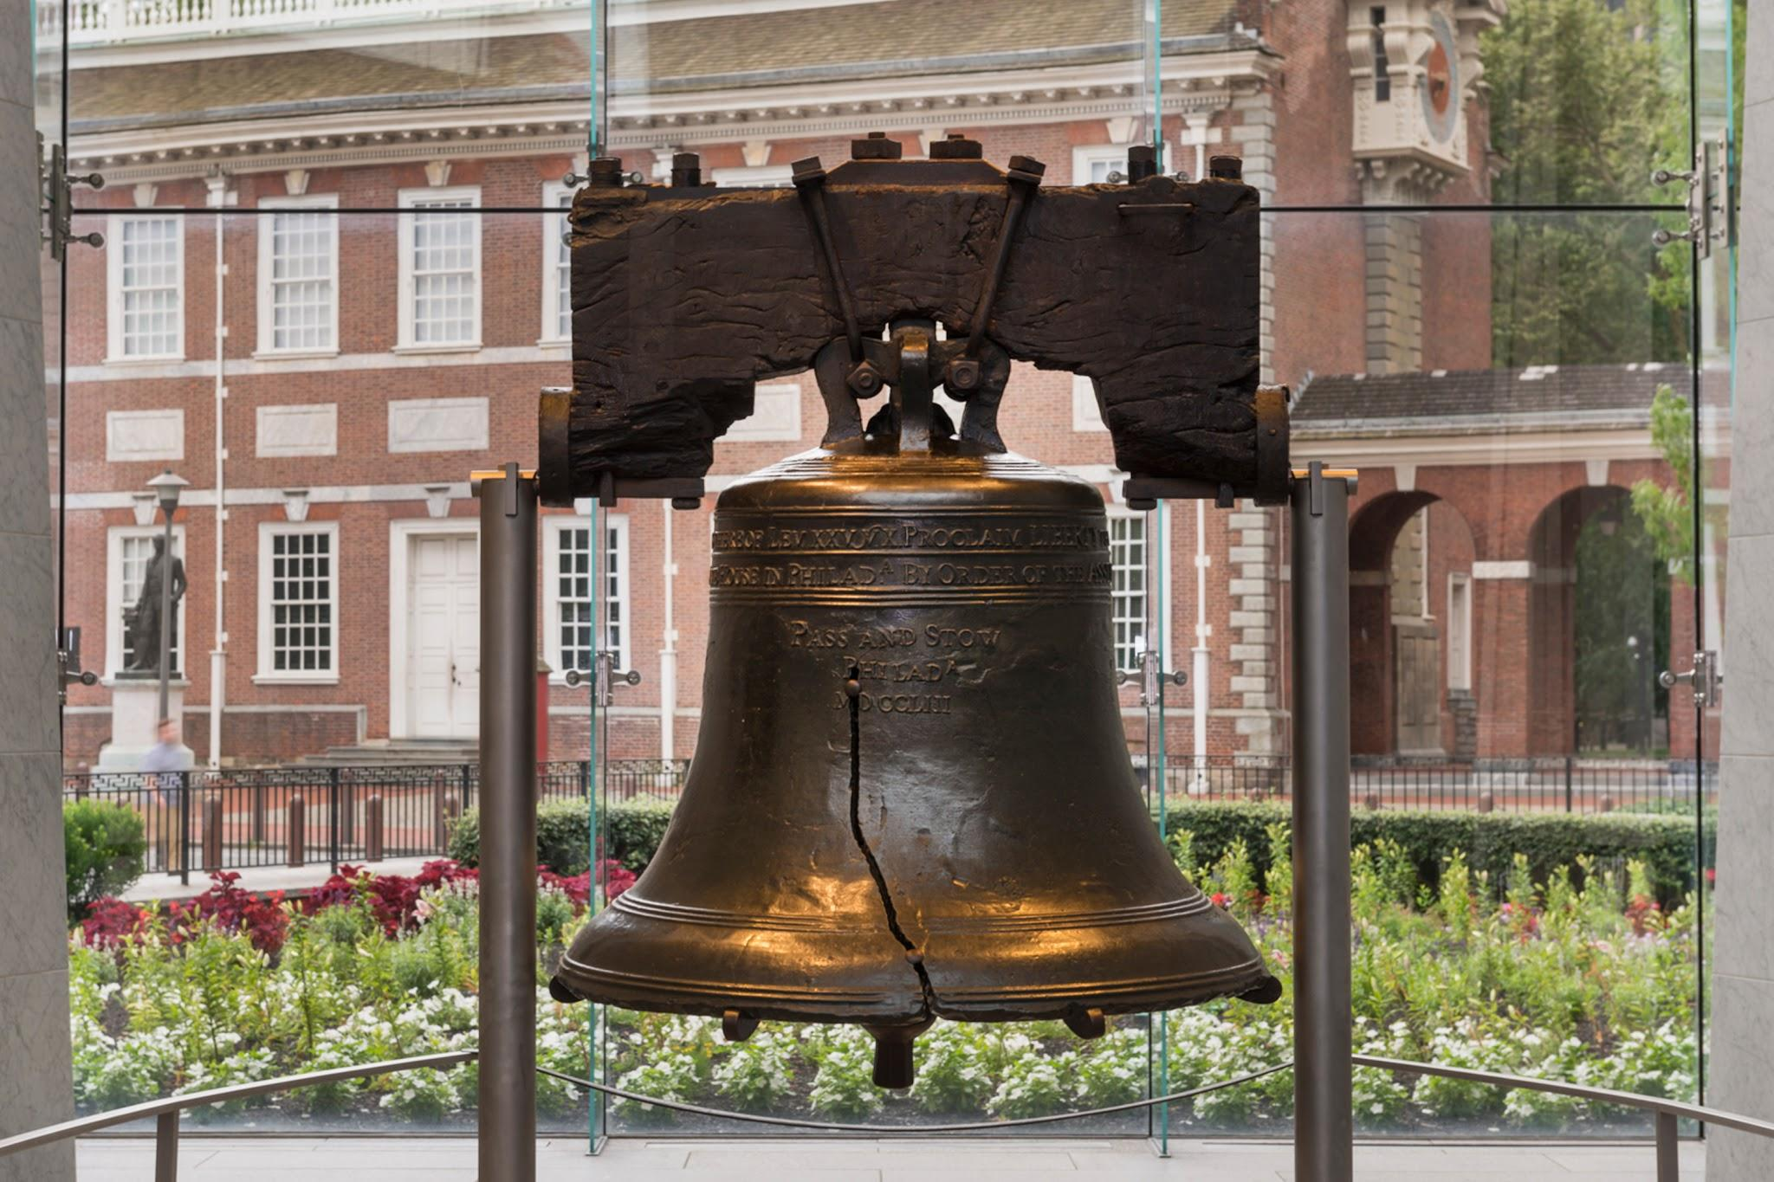

Slide 4
What’s Next?
Connor Harbison

Slide 5
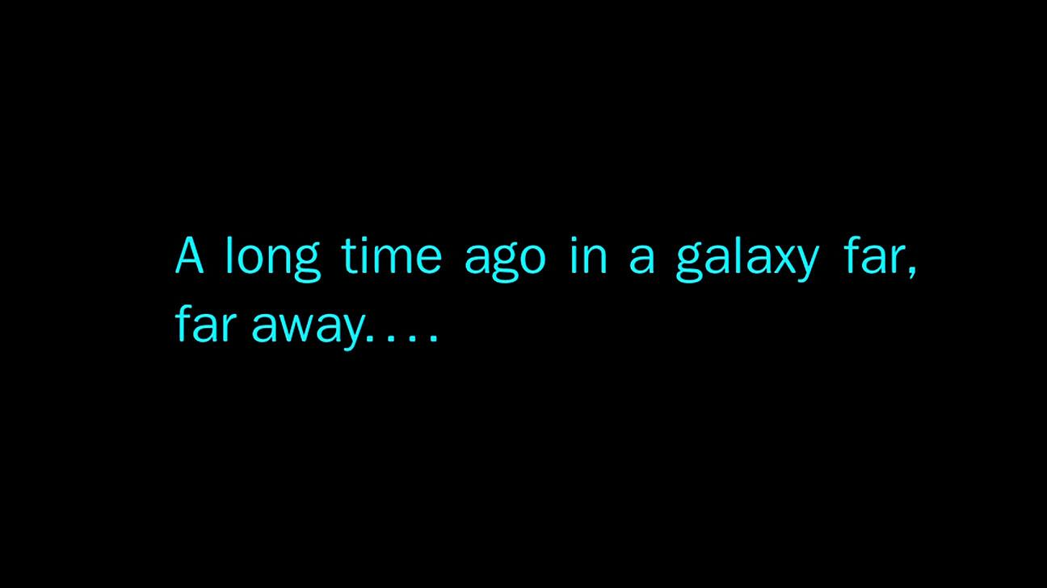

Slide 6
A Story is an Information Container
Mos Eisley is a wretched hive of scum and villainy.
These are NOT the droids you are looking for.
Han shot first.
Death Star is NOT a moon.
The secret Rebel Base is on Yavin IV.
...plus so much more!

Slide 7
How to organize your container
What
Who
How
Why

Slide 8
What.

Slide 9
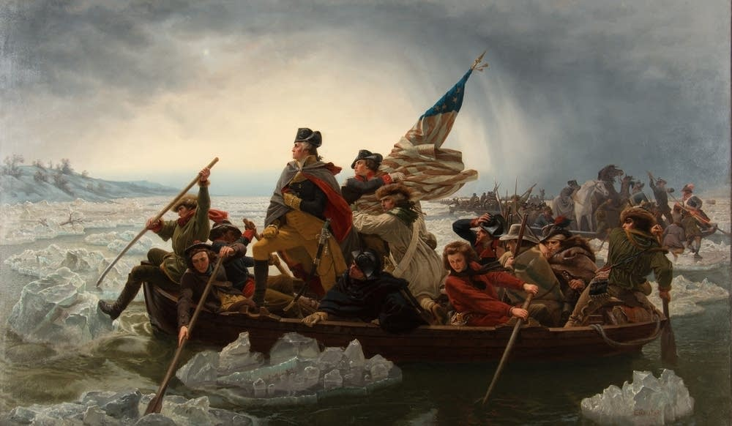
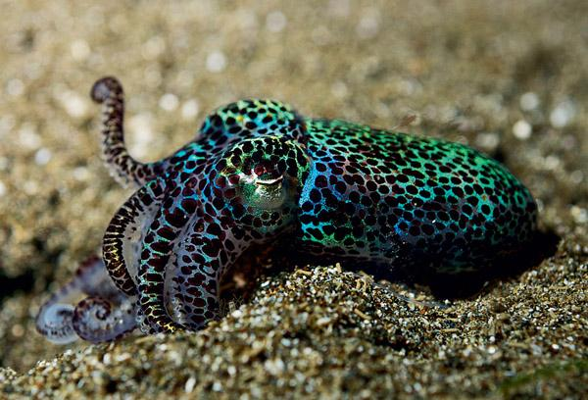
Colonists vs. Cuttlefish

Slide 10
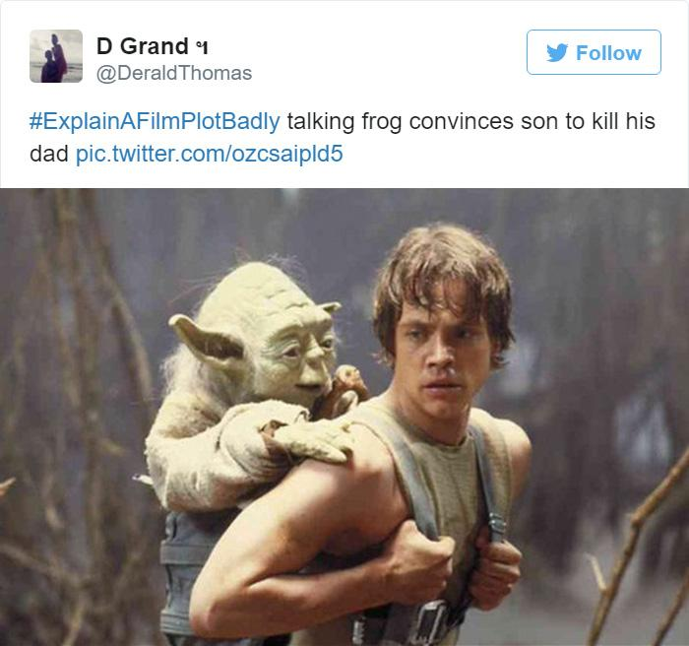
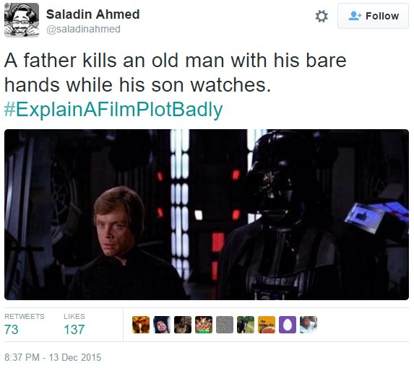
#ExplainAFilmPlotBadly

Slide 11
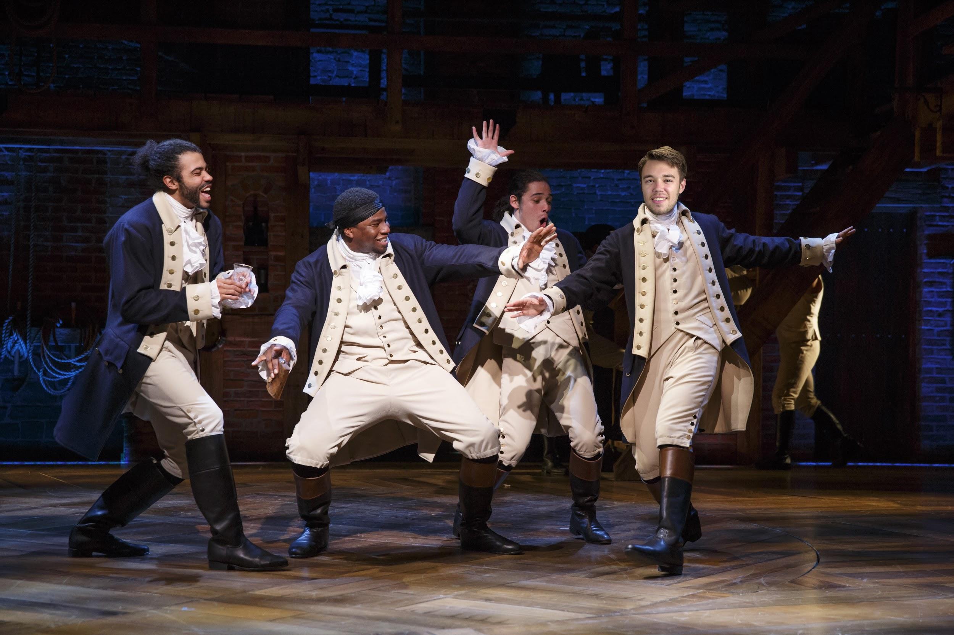
#ExplainYourselfBadly
Local Man Goes on Walkabout in Historic Philadelphia
Great networking opportunity with international contacts
Experience National Parks on foot
Historian yells at schoolchildren

Slide 12
Who.

Slide 13
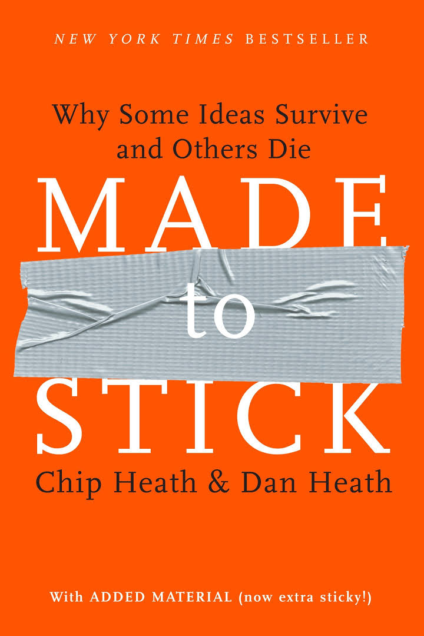
Make your story sticky to your audience
Make it emotional
Violate expectations
Make it concrete
Make it credible

Slide 14
How.

Slide 15
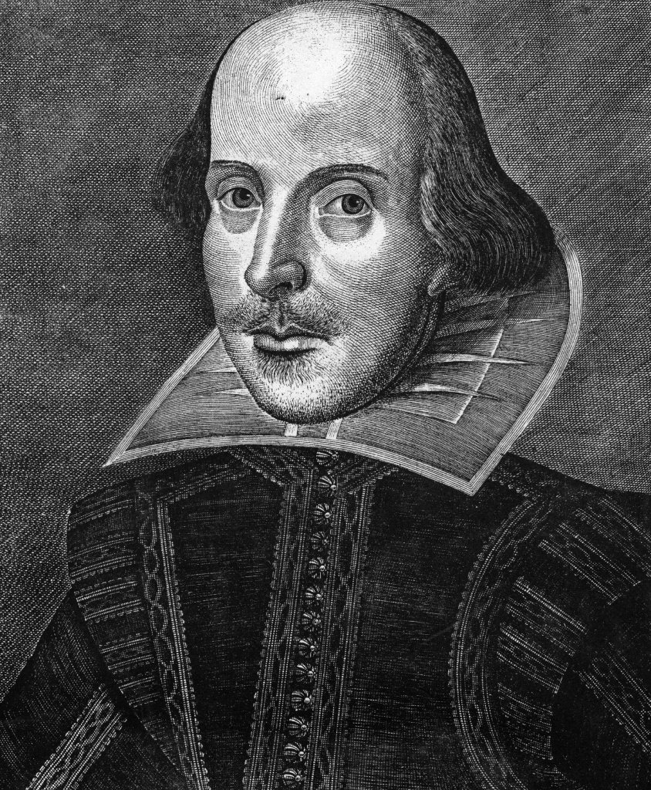
Dramatic Structure
Introduce your hero
Put your hero in a hole
Get your hero out of the hole

Slide 16
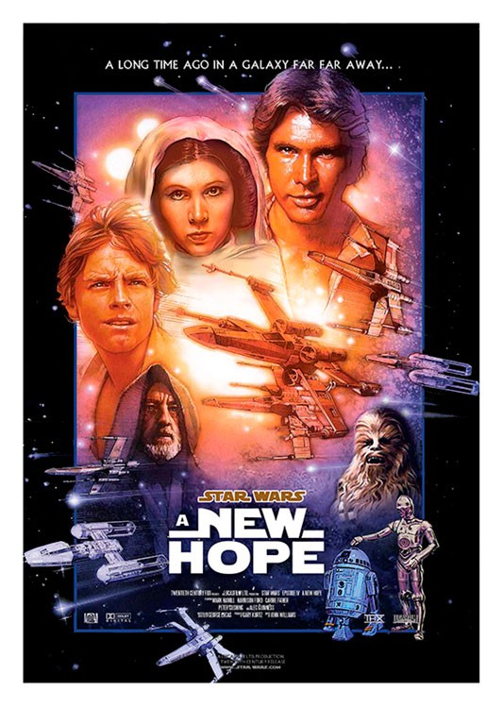
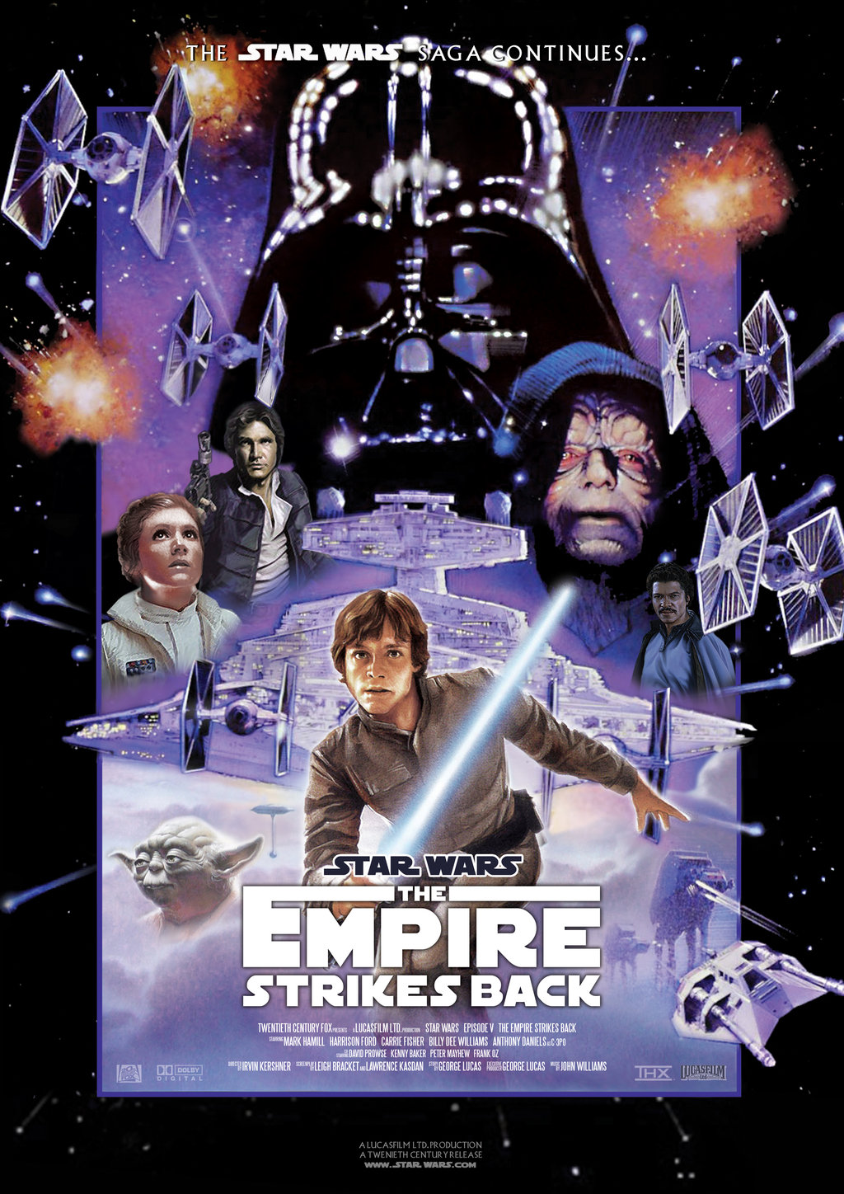
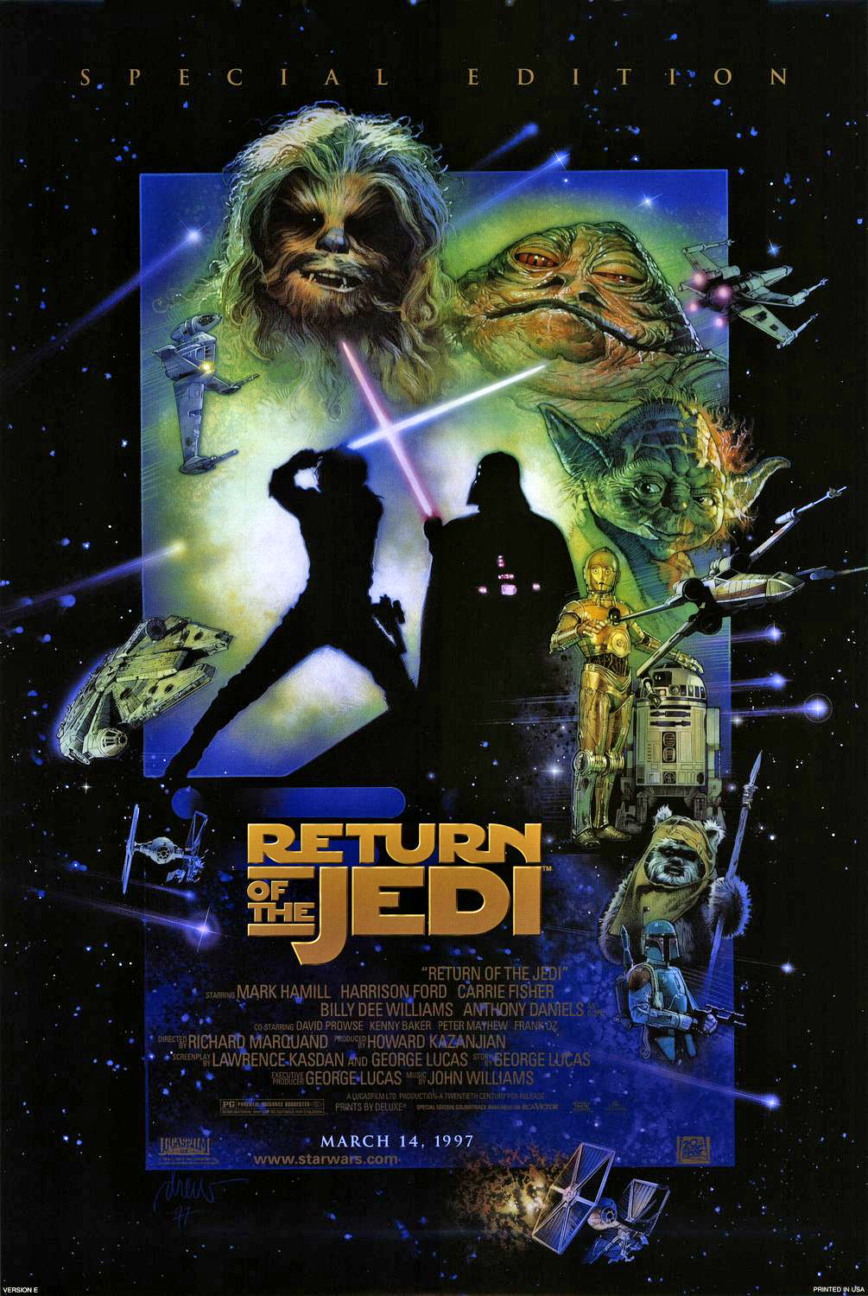
3 Act Structure

Slide 17
Beginning...

Slide 18
...Middle...

Slide 19
...End

Slide 20
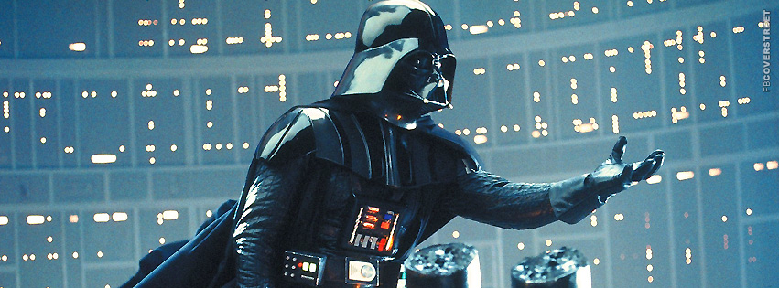
Now you do it!
Tell a three sentence story to your neighbor

Slide 21
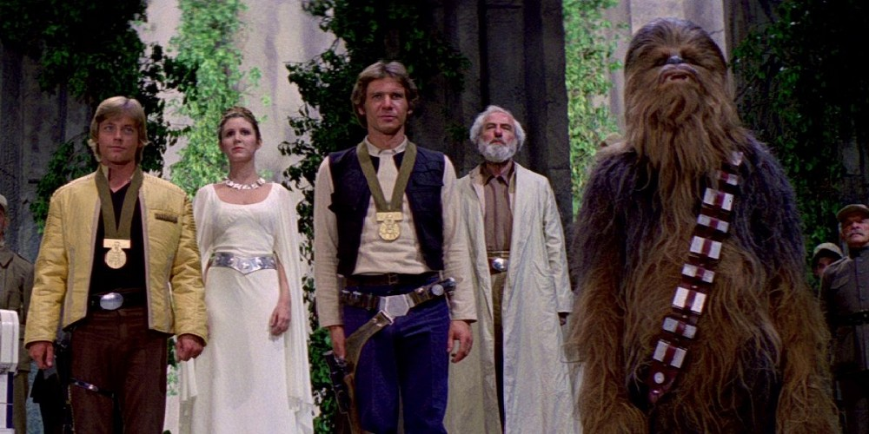
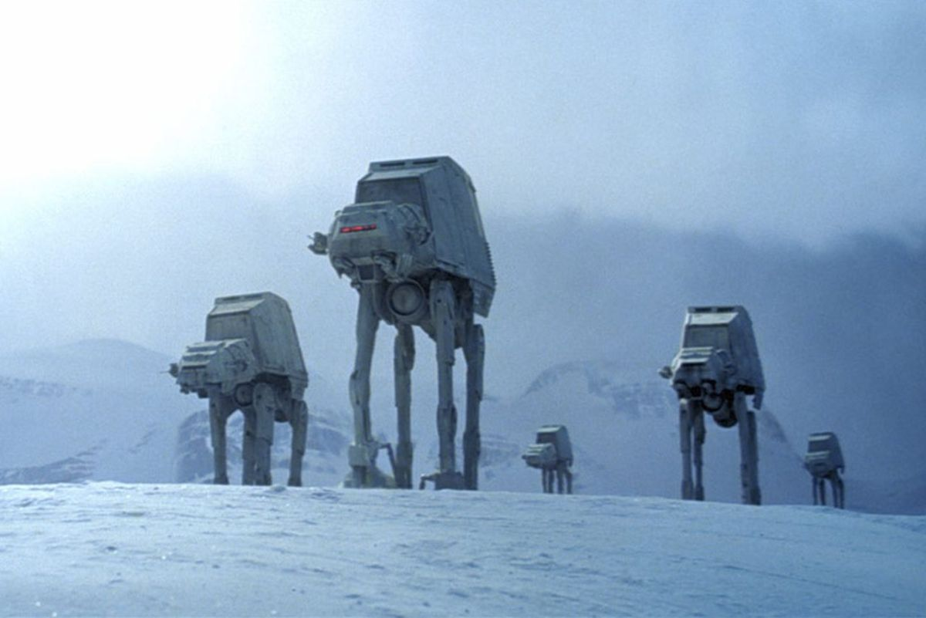
Know how to frame it

Slide 22
Why.

Slide 23
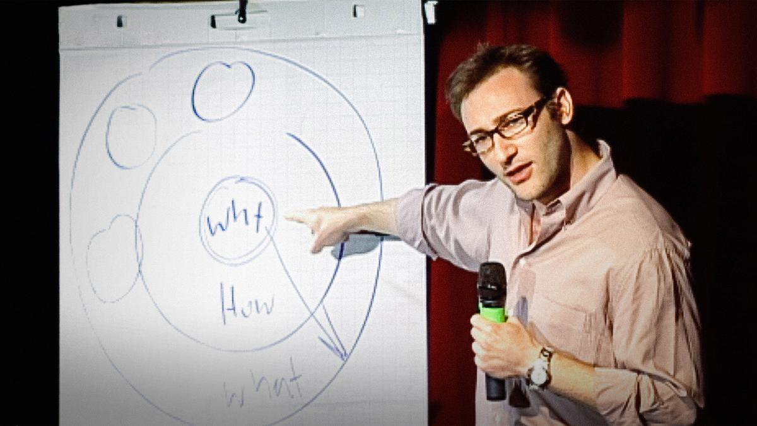
Simon Sinek: Start With Why

Slide 24
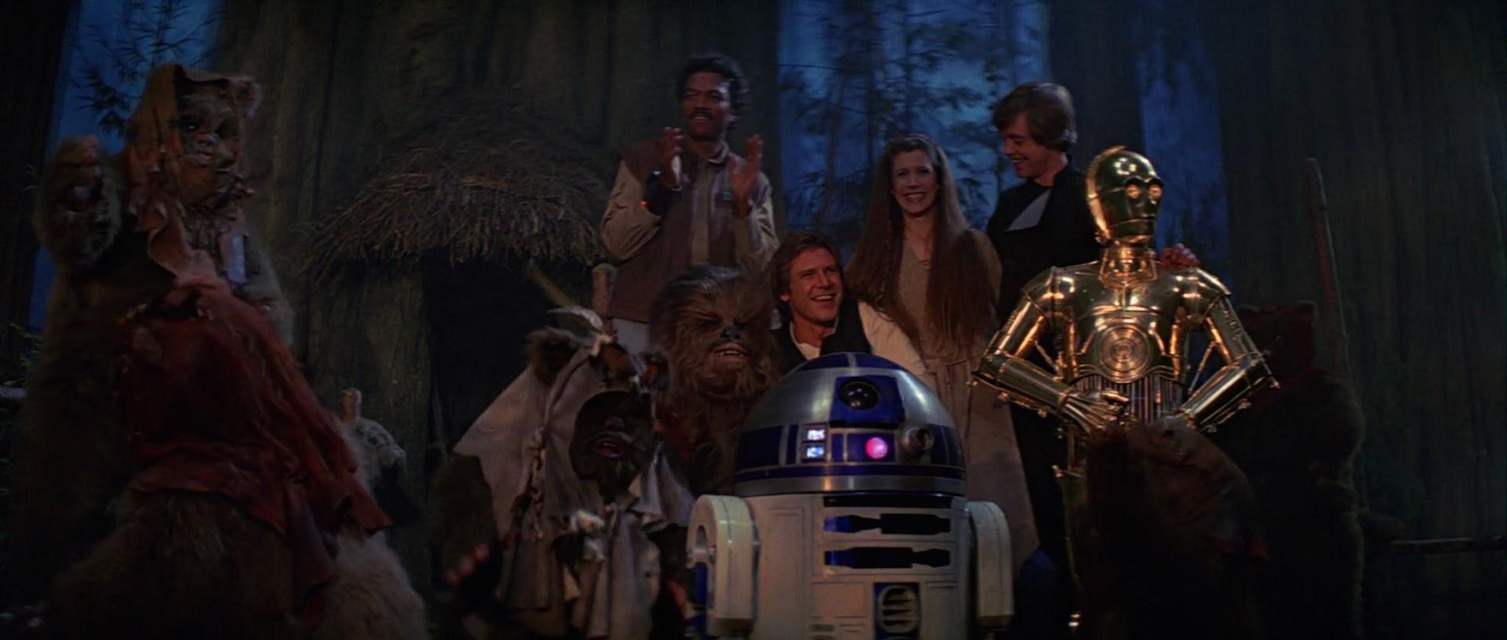
Have fun with it!

Slide 25
Thank You!
Connor Harbison
(215) 620-7637
harbison.connor@gmail.com
linkedin.com/in/connorharbison
@connorharbison

